Slide 1
MPGD Overview
CEPC2017 workshop
Atsuhiko Ochi, Kobe University

Slide 2
Contents
Introduction to MPGDs
MPGD in High Energy Physics
RD51: international MPGD collaboration
Recent topics of MPGD R&D

Slide 3
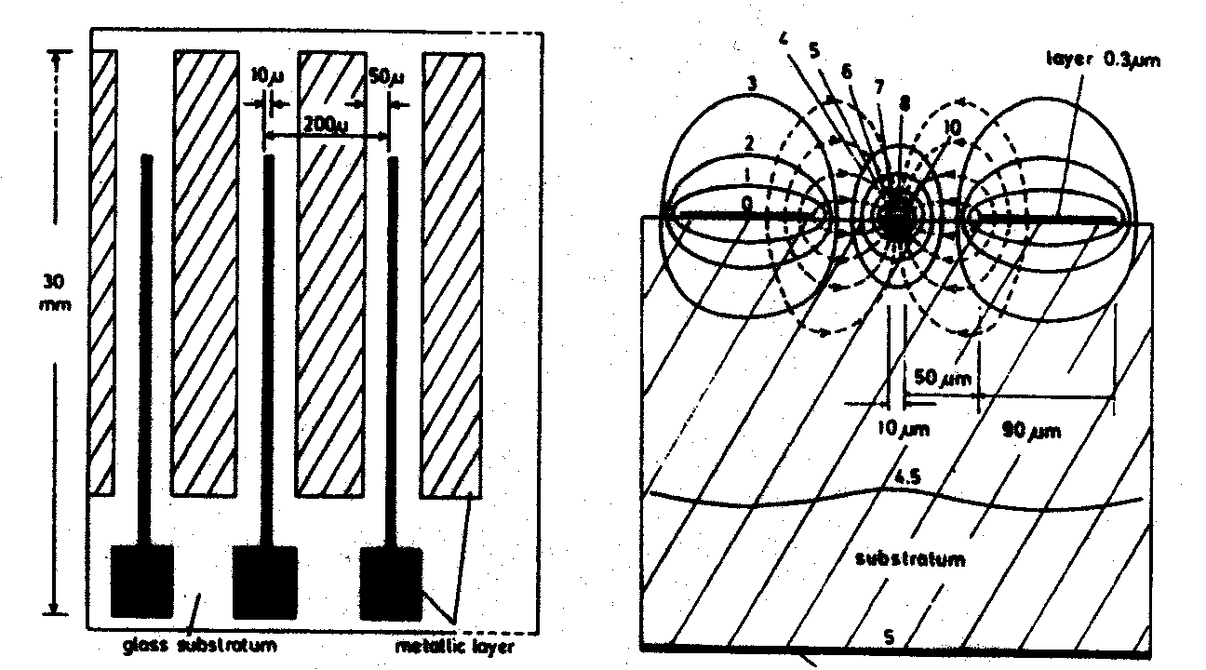
Introduction to MPGD: (Micro Pattern Gaseous Detector)
Using PCB (Printed Circuit Board) technology, we can make fine electrodes for 10μm order.
MSGC (Micro Strip Gaseous Counter) 1988
A. Oed (France)
Fine position resol.(～30μm)、 High rate capability （10⁷ /mm²/s）
However, stability is not sufficient

Slide 4
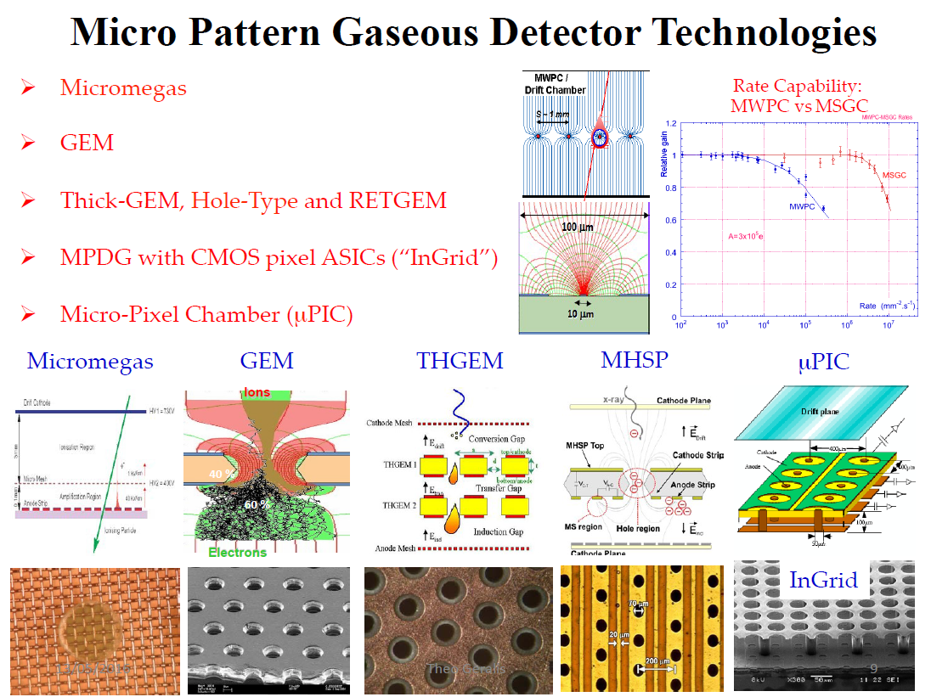

Slide 5
Properties of MPGDs
Gas multiplication and/or read out are performed by “micro pattern” instead of conventional wire chambers
Fine patterning realized …
Fine position resolution ( < 100 micron )
Fine timing resolution ( < 10nsec )
High operational capacity for intense irradiation ( > 10⁷ counts/mm )
….

Slide 6
MPGDs: Probably one of the most versatile technology
High Granularity
Charged Particles
Single Stage
Fast
Radio-Pure
Photons
Multi Stage
Hybrids (different MPGD)
Low Material Budget
Neutrons
Very High Gain
Thin Drift
Flushed
Tracking
Low Gain
Large Drift
Sealed
Calorimeter
No Gain
Charge readout
TPC
Thin Windows
Light readout
Small
Conversion in gas
Large
Mixture
Low Fields
Pure Noble Gas
Conversion outside the gas
High Fields
In the extreme case.. Without gas
Pure Quencher
High Pressure
Ambient Pressure
Planar
Spherical
Low Pressure
Semi-Cylindrical
High Rate
Cylindrical
Low Rate
Self Triggering
Pads
Strips

Slide 7
MPGD in High Energy Physics

Slide 8
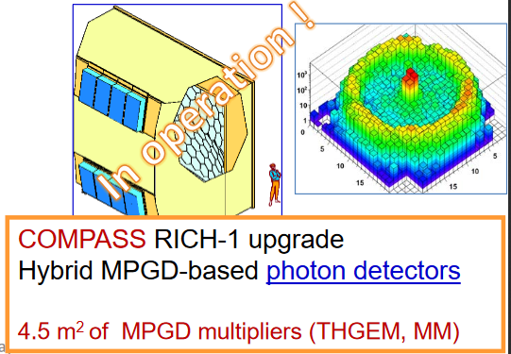
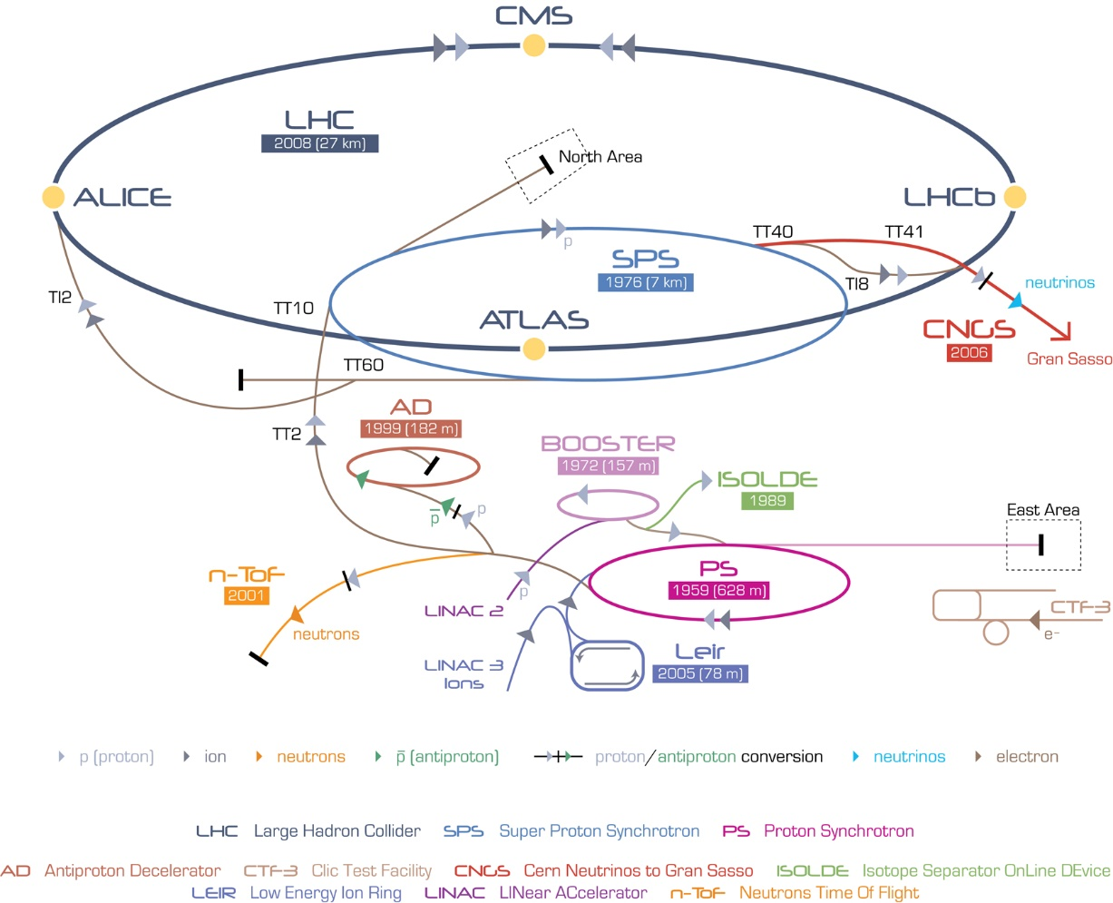
E. Oliveri, MPGD2017
Some of them running,
Some of them approved for upgrades
Some of them under evaluation
Fresh Installation
TOTEM (GEM)
CMS(GEM, μRWELL)
COMPASS(2TGEM+mm, micromegas, GEM)
GLACIER(LEM)
NA48 (micromegas)
ALICE(GEM)
LHCb (GEM, μRWELL)
CAST(micromegas,InGrid)
ATLAS(micromegas)
DIRAC (MSGC-GEM)
RED = LHC
MPGDs and CERN

Slide 9
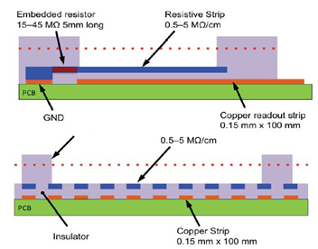
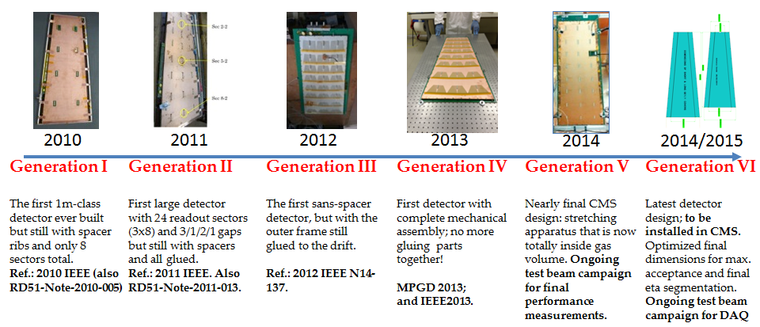
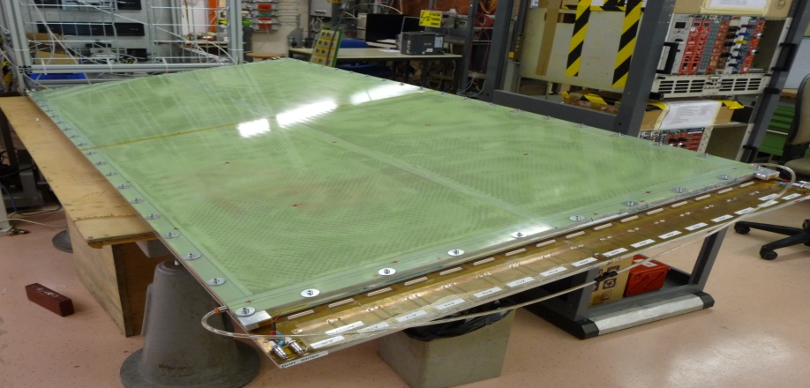
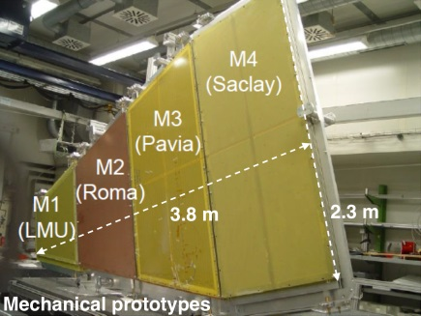
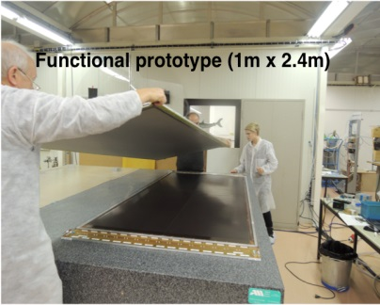
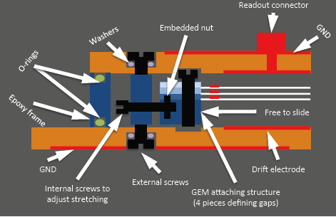
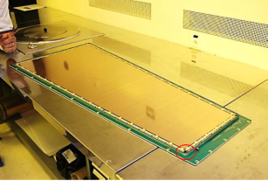
GEM / Micromegas : ATLAS and CMS upgrades
Development and optimization of large-area MPGDs for tracking and triggering
MM for the ATLAS Muon System Upgrade:
GEMs for the CMS Muon System Upgrade:
Standard Bulk MM suffers from limited efficiency at
high rates due to discharges induced dead time
Solution: Resistive Micromegas tecgnology:
Single-mask GEM technology (instead of double-mask)
Reduces cost /allows production of large-area GEM
R&D: 6 generations of triple-GEM detectors
Assembly optimization: self-stretching technique: assembly time reduction from 3 days → 2 hours
→ Add a layer of resistive strips above the readout strips
Spark neutralization/
suppression (sparks still occur, but become inoffensive)
2.4 x 1m²
MM resistive chamber constructed and characterized at CERN RD51 lab

Slide 10
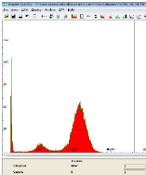
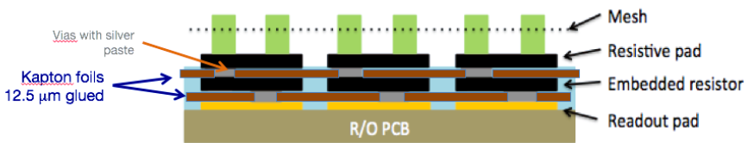
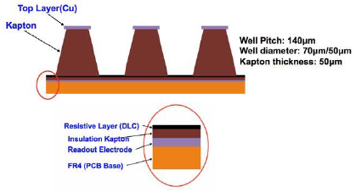
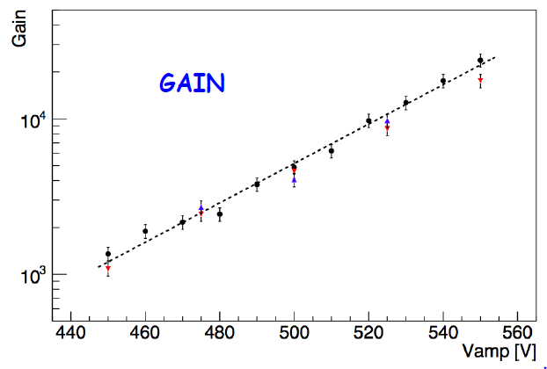
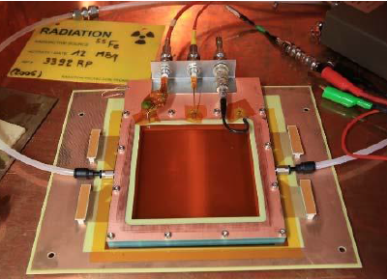
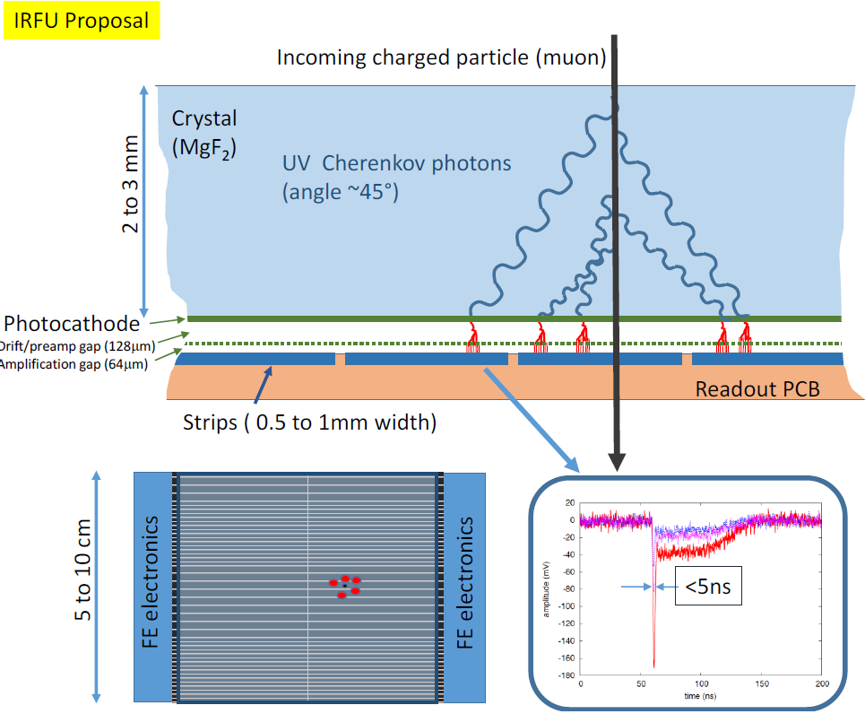
Further upgrade of ATLAS (2023~)
For large eta muon detector
Very high rate ~ 10⁷Hz/cm²
Pixelalated Micromegas
Micro-Resistive WELL
Resistive μ-PIC
Fast timing Micromegas
Drift plane
DLC cathodes
Use of pico second timing resolution
400 μm
Spark rates in Neutron
Resistive cathode (-HV)
Anode
Thin
substrate
(35 μm)
Pickup electrode
Thick substrate
50 μm

Slide 11
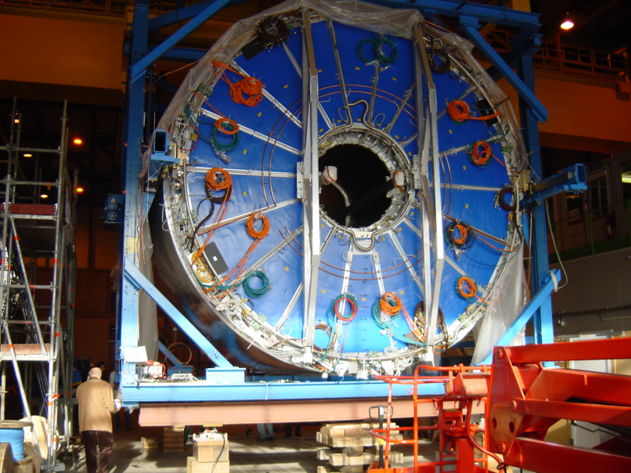
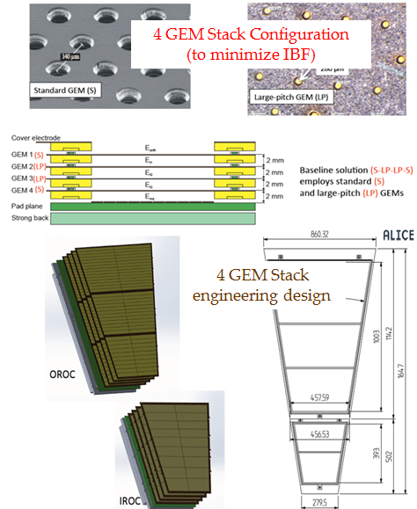
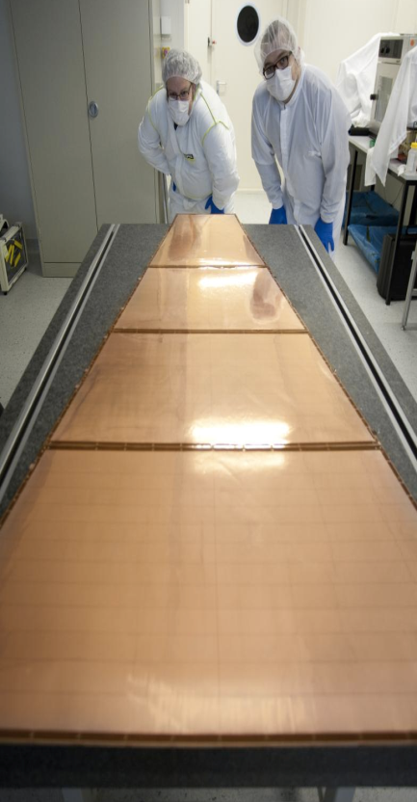
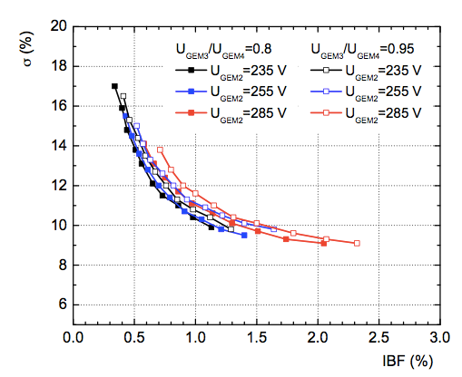
ALICE Time Projection Chamber Endplate Upgrade with GEMs
ALICE TPC Upgrade → replace MWPC with 4-GEM
(to limit space charge effects)
Continuous TPC readout for 50 kHz Pb-Pb readout
Maintain physics requirements:
IBF < 1%, energy; σ(E)E < 12% achieved
IROC
OROC1
Ion Back Flow in a GEM system reduced from > 5 % (3 GEM) to < 1% (4 GEM)
discovered enhanced ion trapping
at high rates
OROC2
OROC3
Preproduction:
Single-mask GEM allows for production
of ~1 m foils
C. Garabatos

Slide 12
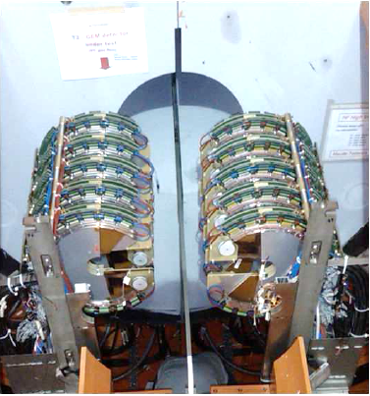
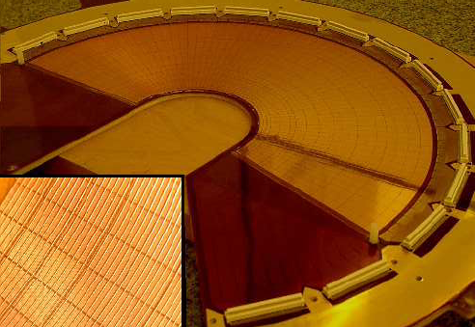
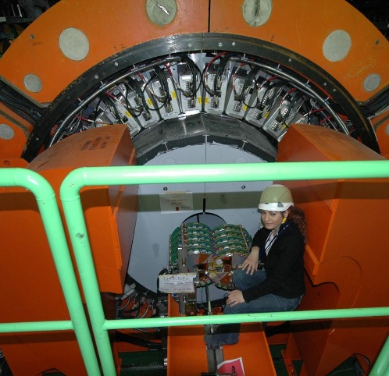
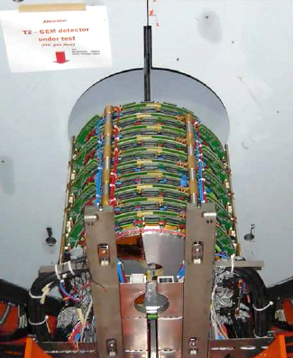
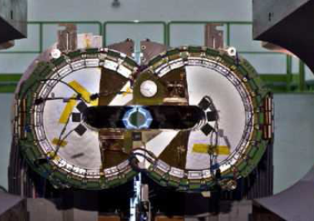
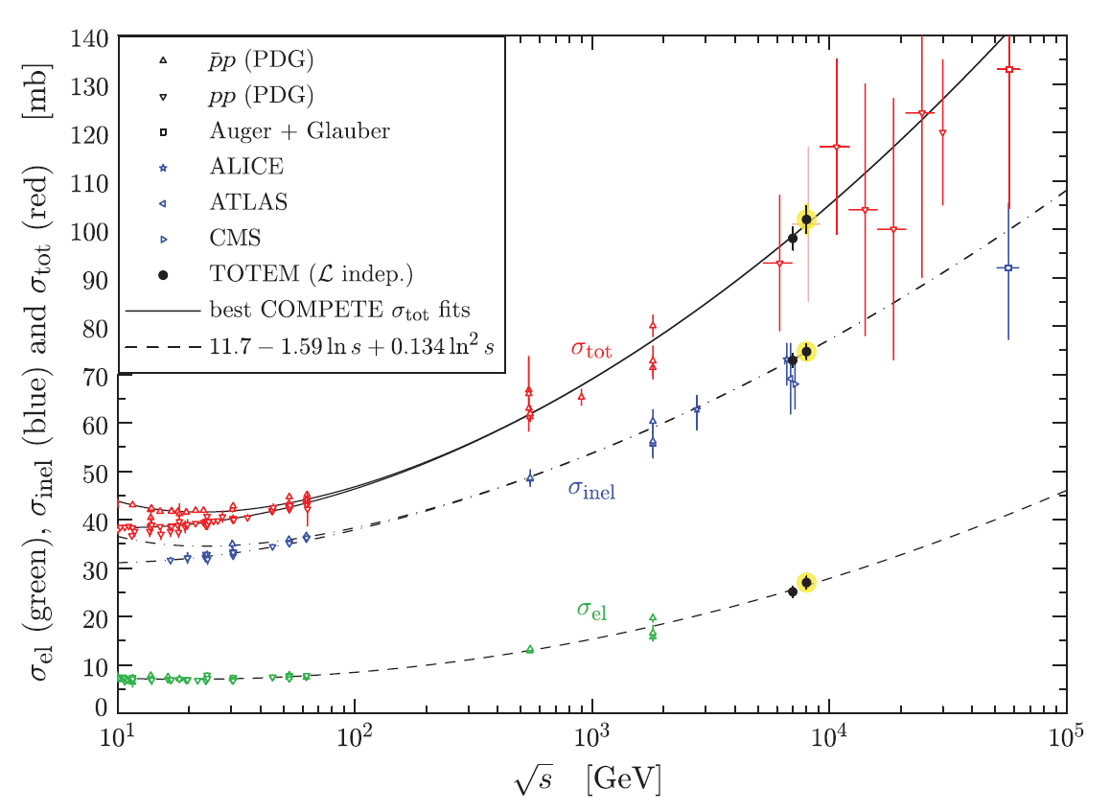
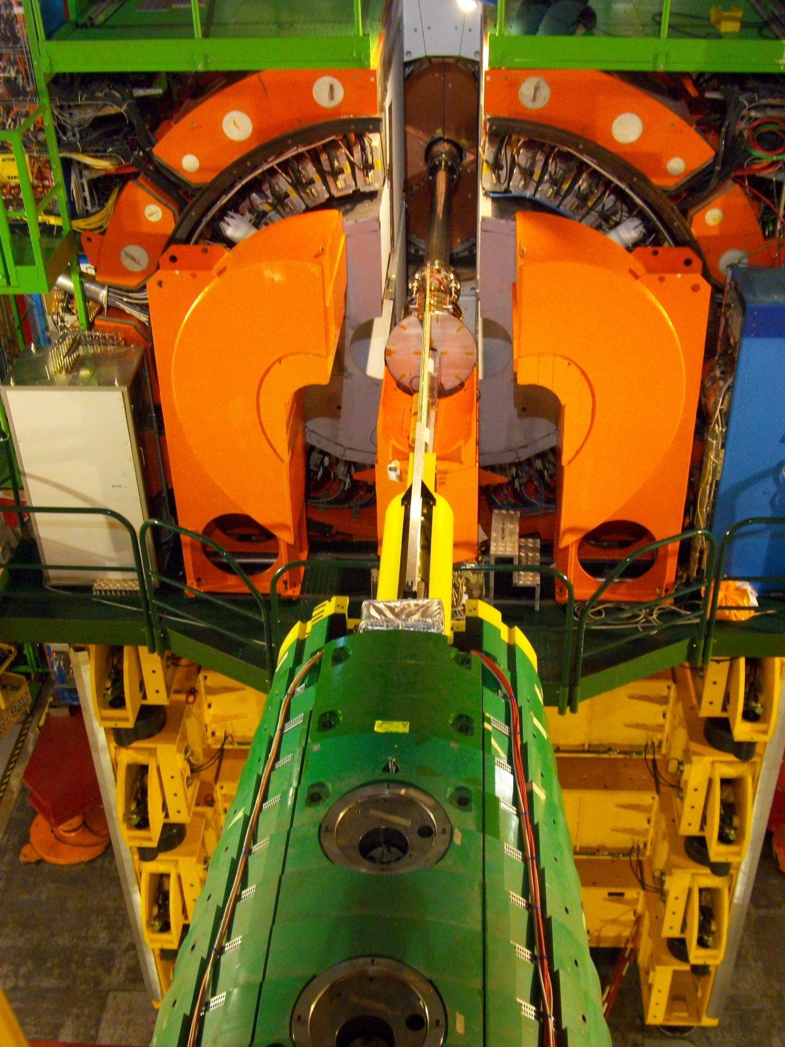
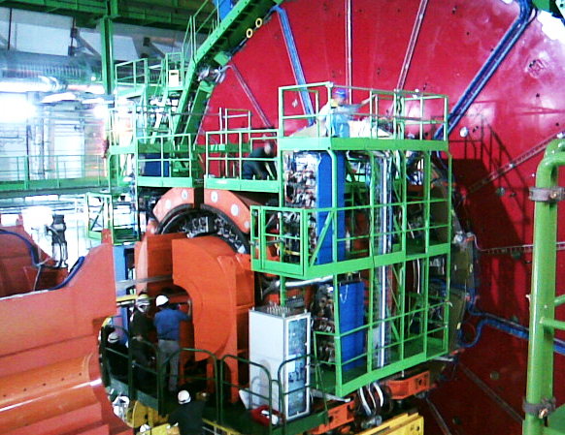

TOTEM GEM Tracker @ LHC
E. Oliveri
Stable operation at very high rates up to 12 MHz/cm²
Achieved spatial (time) resolution: 135 μm (7 ns) at high intensity 2* 10⁸ s⁻¹
Open
Closed
TOTEM Readout Plane
Sensitive
area
Δϕ=192º
Δϕ=192º
total, inelastic and elastic cross-section measurement

Slide 13
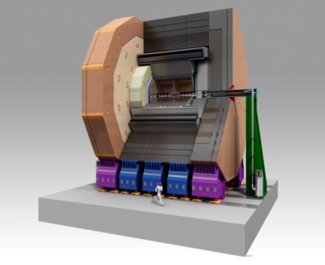
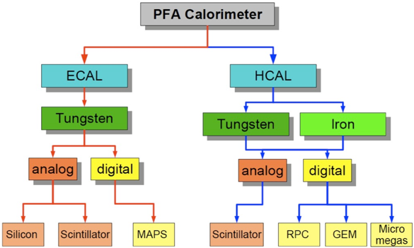
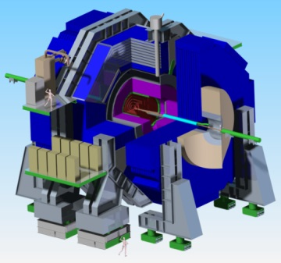
MPGD Technologies for the International Linear Collider
Experiment/ timescale | Application domain | MPGD technology | Total detector size (single module size) | Operation characteristics/ performance | Special requirements/ remarks
ILC Time Projection Chamber (pad and pixel readout) for ILD: Start > 2030 | High Energy Physics (tracking) | Micromegas GEM | Total area: ~ 20 m² Single unit detect: - pad readout: ~ 400 cm² - pixel readout: ~ 130 cm² | Max. rate: < 1 kHz Spatial res.: <150µm Time res.: ~ 15 ns dE/dx: 5 % (Fe55) Rad. Hard.: no | Si + TPC Momentum resolution : dp/p < 9*10-⁵ 1/GeV
ILC Particle Flow Hadronic (DHCAL) Calorimetry for ILC/SiD Start > 2030 | High Energy Physics (calorimetry) | GEM, THGEM RPWELL, Micromegas | Total area: ~ 4000 m² Single unit detect: 0.5 - 1 m² | Max.rate:1 kHz/cm² Spatial res.: 1cm² cells Time res.: ~ 300 ns dE/dx: 12 % (Fe55) Rad. Hard.: no | Jet Energy resolution: 3-4 %
ILD
Concept:
Particle Flow Calorimetry (ILD/SiD):
SiD
Concept:

Slide 14
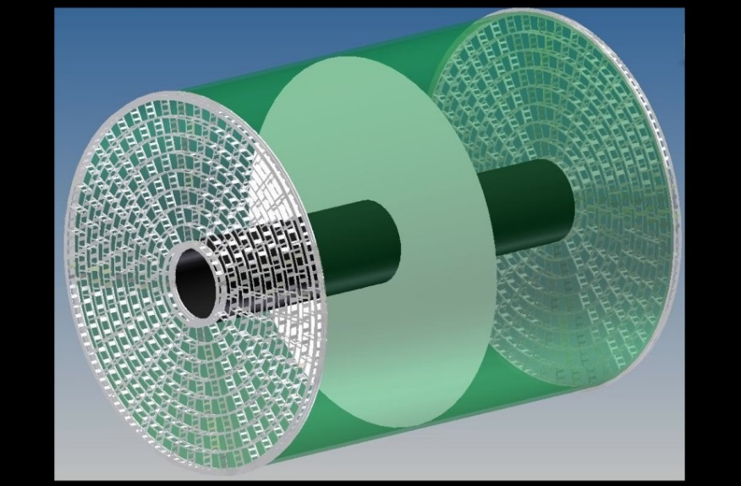
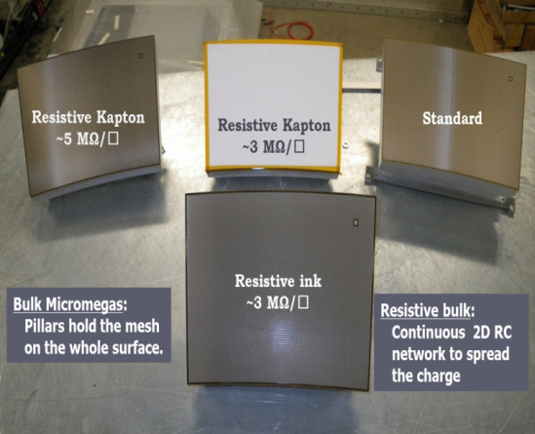
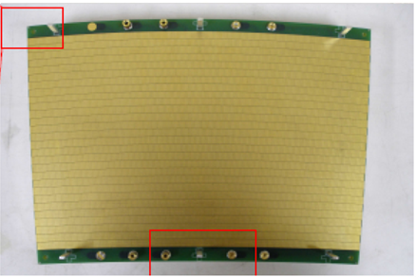
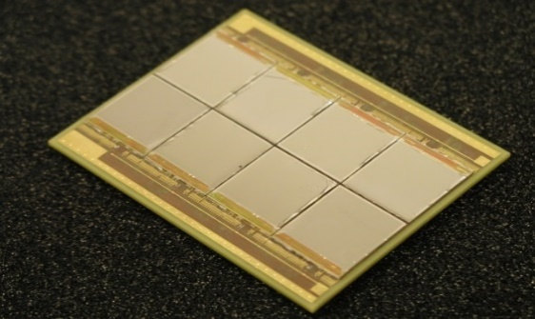
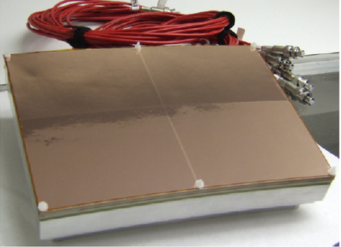
ILC Time Projection Chamber (TPC): MPGD-Based Readout
MPGDs are foreseen as TPC readout for ILC (endcap size~10 m²):
Standard “pad readout” (1x 6 mm²): 8 rows of det. modules (17×23 cm2); 240 modules per endcap
Wet-etched triple GEMs
Laser-etched double-GEMs 100µm thick (“Asian”)
Resistive MM with dispersive anode
“Pixel readout” (55x 55μm²): ~100-120 chips per module → 25000-30000 per endcap
GEM + pixel readout
InGrid (integrated Micromegas grid with pixel readout)
Primary ions create distortions in the
electric field → O(10μm) track distortions
● Machine-induced bkg. and ions from gas
amplification → track distortions 60 μm
=> Gating is needed
● Wire gate is an option
● Alternatively: GEM-gate
Resistive MM /
InGrid :
Laser- etched GEMs /
Wet-etched triple GEM:
InGrid:
J. Kaminski

Slide 15
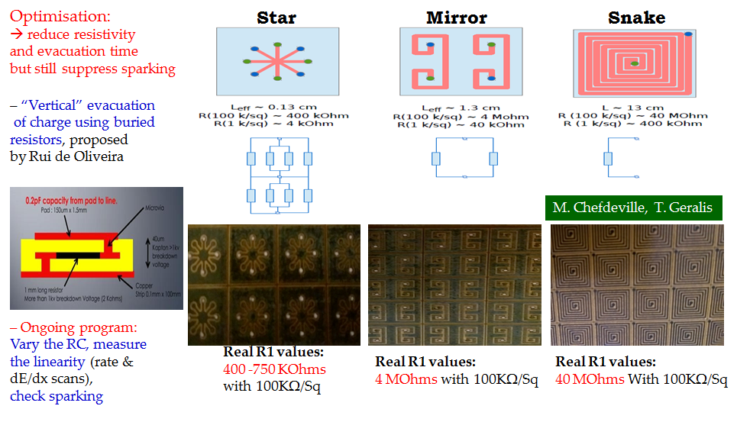
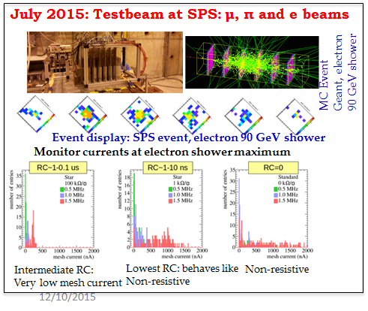
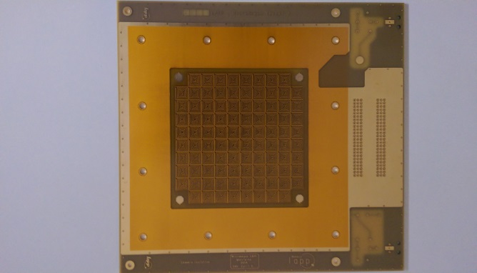
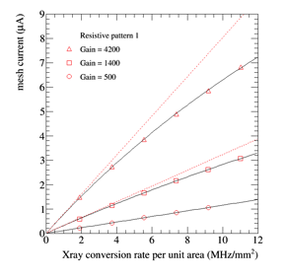
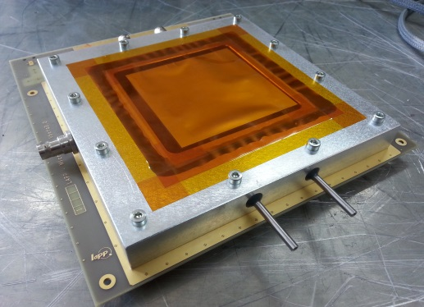
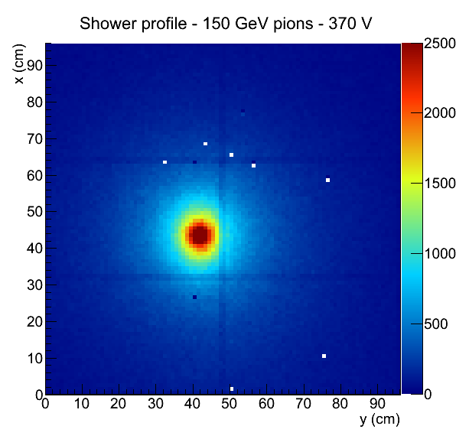
ILC DHCAL Particle Flow Calorimetry: Resistive Micromegas
M. Chefdeville, T. Geralis
Use at future LC or the HL-LHC:
Operation at high rates
Suppress discharges, preserve linearity
High granularity for PF calorimetry,
Small pads ~1x1 cm²,
Large dynamic range (1 – 100s of MIPs)
Tests with X-rays, Cu 8 keV, at high rates:
(intermediate RC, Gain=4000):
Excellent linearity up to 1 MHz/mm²
25% lower Gain at 10 MHz/mm²
PCB with
pads
& resistive
pattern

Slide 16
RD51

Slide 17
RD51
International collaboration for MPGD (Micro Pattern Gaseous Detectors) research and development
Since 2007
The name of “RD51” means, 51st R&D projects in CERN. However, this collaboration is not only dedicated to CERN projects.
Activities:
Collaboration meeting is held on twice a year (one is at CERN)
Additional workshop is held on 1-2 times a year (at CERN)
Facility of large area MPGD production
Common beam test facility in SPPS beamline
Common readout system development: Scalable Readout System (SRS)
Simulation software (Garfield++)
Common project: Matching fund for R&D
Common use of R&D laboratory in CERN
More than 80 institutes (>400 people) are joined.
Spokes person: Leszek Ropelewski (CERN), Silvia Dall Torre (Trieste)
Chair of Collaboration Board: Joao Veloso (Portugal)
Deputy Chair CB: Atsuhiko Ochi (Kobe)

Slide 18
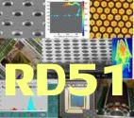
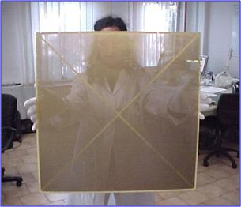

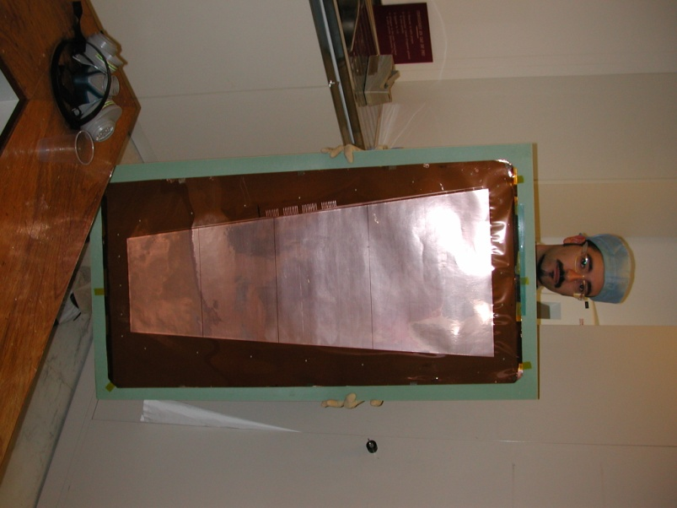
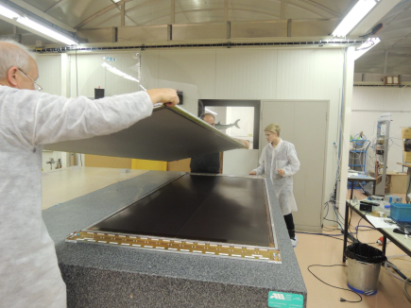
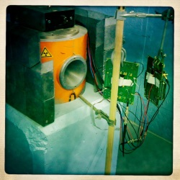
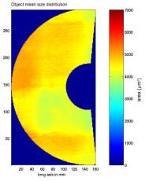
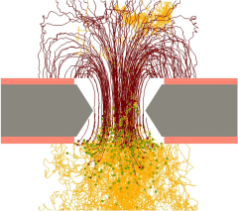









RD51 Collaboration Organization
Large Area Detectors
Assembly Optimization
RD51 Common Projects
Generic R&D, QA
Long Term Stability
WG2:
WG1:
WG5:
Software Tools and
Simulations
MPGD Electronics
RD51
WG4:
WG3/NEW WG:
WG7:
WG6:
Conferences / Schools
Academia-Industry
Matching Events
CERN MPGD
Workshop,
Quality Control
and Industrialization
RD51 Common
Test Beam and Lab Facilities

Slide 19
RD51 and the Rise of Micro-Pattern Gas Detectors
A fundamental boost is offered by RD51: from isolate MPGD developers to a world-wide net
A combined map of organizations working
with MPGDs built with collaboration-spotting
software developed at CERN
→ huge growth in interest in the MPGD
technologies
Collaboration Spotting Software:
http://collspotting.web.cern.ch/)
J.-M. Le Goff

Slide 20

Scalable Readout System
Once upon a time
Complete non experiment-specific read-out systems; for example:
RMH, MWPC read-out developed at CERN; PCOS III by Le Croy
Then, experiment dedicated systems
Still, up-to-date read-out systems available off-the-shelf needed
A must for detector developers, wider use according to needs
Scalable Readout System (SRS) for MPGDs (developed with RD51)
A variety of FE chips: APV25, VFAT, Beetle, VMMx, Timepix
Common acquisition hardware & software
Scalable readout architecture: ~100 ch.s → ~100 k ch. (ATLAS MAMMA project)
So successful, to be used outside MPGDs (SiPM, ALICE Ecal, …)
Cheap!
~ 2 € / ch + FE

Slide 21

Total cost （128ch board X 4 + modules + Crate, etc.) ~ 5000CHF

Slide 22


Development of MPGD Simulation Tools
Focus on providing techniques for calculating electron transport in small-scale structures
The main difference with traditional gas-based detectors is that the electrode scale
(~ 10 μm) is comparable to the collision mean free path
Development and Maintenance of Garfield++: Garfield++ is a collection of classes for the detailed simulation of small-scale detectors.
Garfield++ contains: - electron and photon transport using cross sections provided by Magboltz - ionisation processes in gases, provided by Heed and MIP - ionisation and electron transport in semi-conductors - field calculations from finite elements, boundary elements, analytic methods Simulation Improvements:
→ Transport:
- ion mobility and diffusion, measurement and modelling
- Magboltz cross sections (Ar, Xe, He, Ne; GeH₄, SiH₄, C₂H₂F₄ ) are frequently
updated in collaboration with LXCAT (http://www.lxcat.laplace.univ-tlse.fr)
- e-ion recombination process in Xe
- thermal motion
→ Photons:
- update in UV emission
- inclusion of IR production
- photon trapping and resulting excitation transport
- photon absorption in the gas (gas feedback)
- photon absorption in and electron emission from walls (feedback)
- photo cathodes

Slide 23
Recent topic for MPGD
Resistive electrodes for MPGDs

Slide 24


Slide 25



Resistive-strip protection concept for ATLAS upgrade
Mesh
(GND)
We can divide the production process of resistive strip from that of readout board.
+HV
Note:
Resistance values
and
Strip pitches and sizes are only for illustration
Resistive strip is formed by large size screen printing

Slide 26
The µ-RWELL architecture
The µ-RWELL detector is composed by two elements:
the cathode and the µ-RWELL_PCB .
Drift/cathode PCB
The µ-RWELL_PCB is realized by coupling:
a “suitable WELL patterned kapton foil as “amplification stage”
a “resistive stage” for the discharge suppression & current evacuation:
“Low particle rate” (LR) << 100 kHz/cm²: single resistive layer → surface resistivity ~100 MΩ/ (CMS-phase2 upgrade - SHIP)
“High particle rate” (HR) >> 100 kHz/cm²: more sophisticated resistive scheme must be implemented (MPDG_NEXT- LNF & LHCb-muon upgrade)
a standard readout PCB
Copper top layer (5µm)
Well pitch: 140 µm
Well diameter: 70-50 µm
Kapton thickness: 50 µm
DLC layer (0.1-0.2 µm)
R ̴50 -100 MΩ/□
1
2
3
Rigid PCB readout electrode
µ-RWELL PCB
G. Bencivenni et al., 2015_JINST_10_P02008

Slide 27



Coupling the DLCed Kapton with r/o-PCBs
gluing the DLCed foils on the readout -PCBs @ MDT

Slide 28




Resistive μ-PIC
Resistive cathode + capacitive readout
Cathode : DLC
Pick-up electrodes are embedded in substrate
Two dimensional readout
Gain ~ 5×10⁴ (Ar 70% + C2H6 30%)
Spark reduction → 10⁻⁴ (@gain=10000)
Gain Curve
Cathode (pickup)
従来型μ-PICの放電率
300mV
Anode
高抵抗陰極型μ-PICの放電率

Slide 29








Well-defined PSF of ETCC: Evolution of MeV gamma-imaging beyond Compton Camera
Kyoto Univ.
30cm-cubic Gaseous Time Projection Chamber
--- tracking of recoil electron ---
SPD ->a Point Spread Function(PSF)
Fine 3D-electron tracking gives ϕ, and well-defined PSF (1-2˚)
PSF ~ 40˚
PSF ~ 1˚
Cosmic γ-ray detector
Significance maps and contours of three ¹³⁷Cs sources with different intensities at a distance of 2 m.
Without tracking information.
Using the arcs with SPD resolution of 200˚ before improving
SPD resolution of 100˚
Combination of SPD resolutions of 90˚ and 45˚
Tanimori et al., ApJ (2015), 810, 28
γ-ray from air
¹³⁷Cs Imaging on ground
Small system
for field measurements.
Weight: 100kg (with batt.)
One day operation available
with once charging
Micro TPC + PSA
1-5μSv/h : Not decontaminated
Power Supply
From ground
(Low dose)
Preliminary
From ground
(High dose)
Environmental γ-ray camera
(for nuclear plant disaster)
Battery (25V, 100Ah)
<1Sv/h : Decontaminated

Slide 30



Very fast timing (Pico second order)
Semitransparent mode
Charged particle
~80 photons/cm
crystal
photon
photocathode
electron
preamplification
micromesh
avalanche
anode
insulator

Slide 31
Localizing the e⁻ creation point
Limit the direct gas ionization
use a radiator / photocathode electron emitter:
Cherenkov light produced by charged particles crossing a MgF₂ crystal
Photoelectrons extracted from a photocathode (CsI)
Simultaneous & well localized ionization of the gas (time jitter for the Cherenkov light ~10 ps)
Well defined, small drift gap with strong electric field (~10kV/cm), or no drift
Reflective mode
Semitransparent mode
Charged particle
Charged particle
~80 photons/cm
~80 photons/cm
crystal
crystal
photon
photon
photocathode
electron
preamplification
electron
photocathode
micromesh
micromesh
avalanche
avalanche
anode
anode
insulator
insulator

Slide 32
Summary
There is many type of MPGDs with versatile.
For current and future HEP experiments, there are many projects for large are, high rate capability, precise resolution, fast timing, low IBF …
The RD51 is international MPGD collaboration with exchange ideas, share the facilities and developing common readout system and simulation tools.
Thank you !

Slide 33
Backup

Slide 34
MPGD@High Energy Physics
Experiment/ timescale | Application Domain / | MPGD technology | Total detector size / single module size | Operation characteristics/ performance | Special requirements
ATLAS Muon System Upgrade Start: 2018-2019 Operation > 15years | High Energy Physics (Tracking/ Triggering) | Micromegas | Total area: 1200 m² Single unit detect: (2.2x1.4m² ) ~ 2-3 m² | Max. rate:15 kHz/cm² Spatial res.: <100µm Time res.: ~ 10 ns Rad. Hard.: 1 C/cm² | Redundant tracking and triggering. Robustness against ageing Challenging constraints in mechanical precision:
ATLAS Muon Tagger Upgrade: start > 2023 | High Energy Physics (Tracking/triggering) | μ-PIC | Total area: ~2m² | Max.rate:100kHz/cm² Spatial res.: <100µm
CMS Muon System Upgrade: start > 2020 | High Energy Physics (Tracking/ Triggering) | GEM | Total area: ~ 143 m² Single unit detect: 0.3-0.4m² | Max. rate:10 kHz/cm² Spatial res.: ~100µm Time res.: ~ 5-7 ns Rad. Hard.: 10 LHC y | Redundant tracking and triggering Robustness against ageing
ALICE Time Projection Chamber: start > 2020 | Heavy-Ion Physics (Tracking + dE/dx) | GEM with TPC | Total area: ~ 32 m² Single unit detect: up to 0.3m² | Max.rate:100 kHz/cm² Spatial res.: ~300µm Time res.: ~ 100 ns dE/dx: 12 % (Fe55) Rad. Hard.: 50 mC/cm² | 50 kHz Pb-Pb int. Rate; continues TPC readout Low IBF and good energy resolution
TOTEM Tracking: Start 2009-now | High Energy/ Forward Physics (5.3≤|eta| ≤ 6.5) | GEM (semicircular shape) | Total area: ~ 4 m² Single unit detect: up to 0.03m² | Max.rate:20 kHz/cm² Spatial res.: ~120µm Time res.: ~ 12 ns Rad. Hard.: ~ mC/cm² | Operation in pp, pA and AA collisions.
LHCb Muon System Start: 2010 - now | High Energy / B-flavor physics (muon triggering) | GEM | Total area: ~ 0.6 m² Single unit detect: 20-24 cm² | Max.rate:500 kHz/cm² Spatial res.: ~ cm Time res.: ~ 3 ns Rad. Hard.: ~ C/cm² | Redundant triggering Robustness against ageing
FCC Collider Start > 2035 | High Energy Physics (Tracking/Triggering/ Calorimetry/ Muon detect./) | GEM/MM/ THGEM/ InGrid | Total area: 10.000 m² (for MPGDs around 1.000 m² ) | Max.rate:100 kHz/cm² Spatial res.: <100µm Time res.: ~ 1 ns | Maintenance free for decades

